Slide 1

Measuring the Impact of Multiple Independent Variables on a Dependent Variable
Descriptive, Correlation, Regression, and Residual Analysis
Submitted By,
MOHAMMED SALIH K
M240101MS

Slide 2
Wine Quality Prediction: Problem Statement:
Challenge
To develop a predictive model that accurately assesses wine quality based on chemical properties, replacing subjective, time-consuming traditional tasting methods with a data-driven approach.
Data & Scope
Features (11): Fixed Acidity, Volatile Acidity, Citric Acid, Residual Sugar, Chlorides, Free/Total Sulfur Dioxide, Density, pH, Sulphates, Alcohol
Target: Wine Quality Rating
Objectives
Create a linear regression model to predict wine quality from chemical properties
Identify key chemical factors influencing wine quality

Slide 3
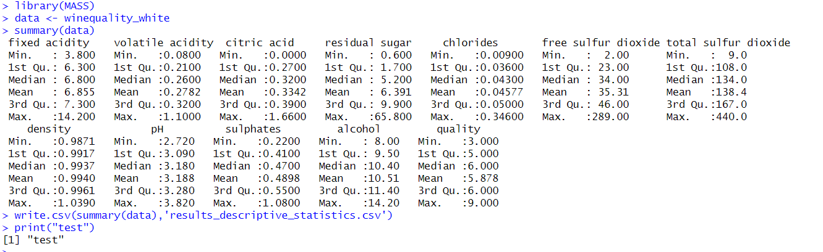
Descriptive Statistics
Descriptive Statistics of White Wine Data
Wide Ranges:
Fixed Acidity: 3.8 - 14.2
Residual Sugar: 0.6 - 65.8 g/L
Total Sulfur Dioxide: 9.0 - 440.0 mg/L
Typical Values:
Median Fixed Acidity: 6.8
Mean Alcohol Content: 10.51%
Median pH: 3.18
Variability Observed:
Skewed Distributions for Residual Sugar, Chlorides
Potential Outliers in Sulfur Dioxide
Key Learnings:
Wide ranges in wine properties (e.g. fixed acidity 3.8-14.2, residual sugar 0.6-65.8 g/L)
Typical profiles (median fixed acidity 6.8, mean alcohol 10.51%, median pH 3.18)
Skewed distributions and potential outliers (residual sugar, chlorides, sulfur dioxide)
Opportunities for further analysis on drivers of wine quality and style

Slide 4
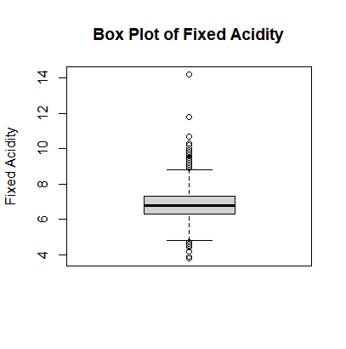
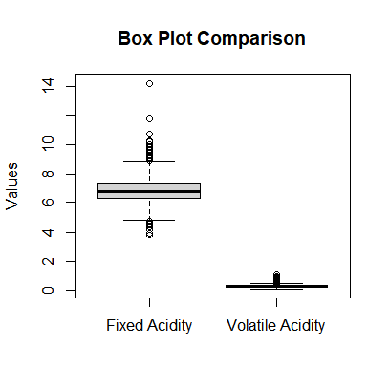
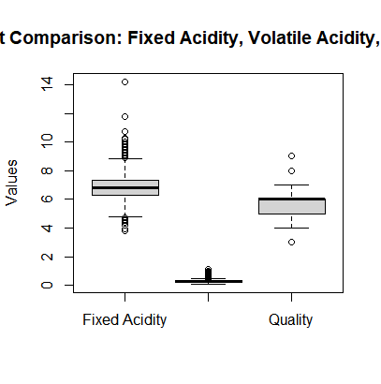
Box Plots
Key Insights from the Box Plot Visualizations:
The box plot of fixed acidity shows a wide spread, indicating high variability in this wine property.
Comparing the box plots, fixed acidity has a broader distribution than volatile acidity.
The box plot with fixed acidity, volatile acidity, and quality shows fixed acidity has the widest spread, while quality is less variable.
The comprehensive three-variable box plot reveals the relationships between these important wine characteristics.
These visualizations highlight the significant variability in the fixed acidity of the wine samples, as well as how it compares to other key properties like volatile acidity and quality. This provides a foundation for further exploration of factors influencing wine composition and quality.
Box Plot with single variable
Box Plot with two variable
Box Plot Comparison with Fixed acidity, Volatile acidity, Quality
Box Plot with three variable

Slide 5
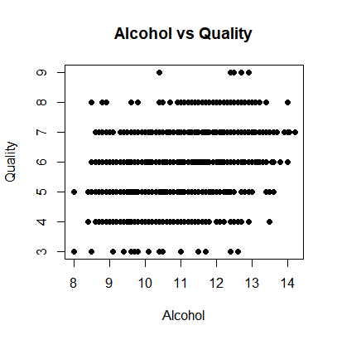
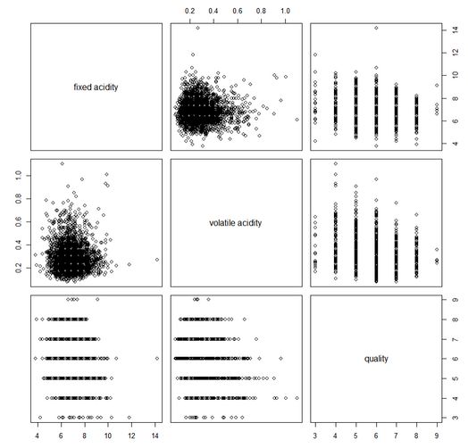
Scatter Plot
Scatter plots between independent variable and the dependent variable
Statistical Inferences and Key Insights
Alcohol vs. Quality
Slight positive correlation: Higher alcohol may improve quality.
Quality mostly clustered around 5-6, suggesting other influencing factors.
Pair Plot Observations
Fixed Acidity & Quality: Limited impact, no clear trend.
Volatile Acidity & Quality: Slight negative impact but weak correlation.
Multi-Variable Influence: Quality influenced by multiple variables; no single predictor is dominant.
Key Takeaways
Complexity of Quality Determinants: Multi-variable approach needed to understand quality.

Slide 6
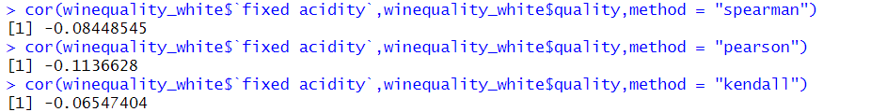
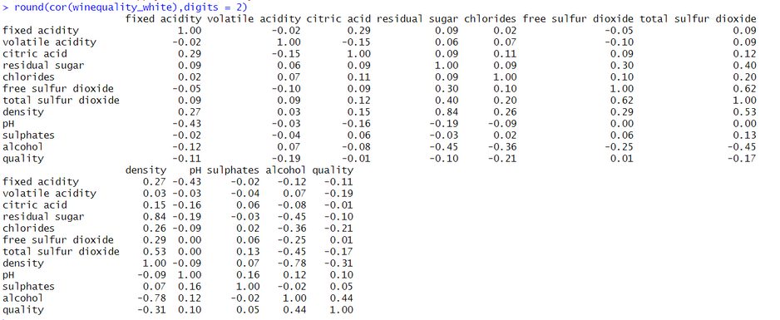
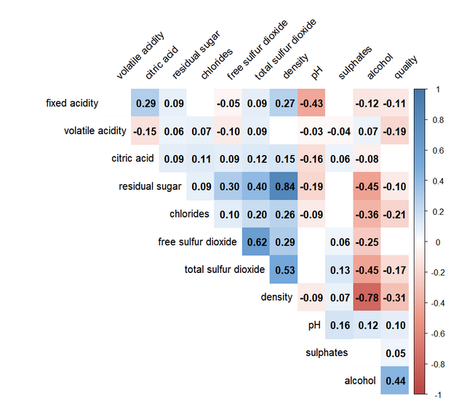
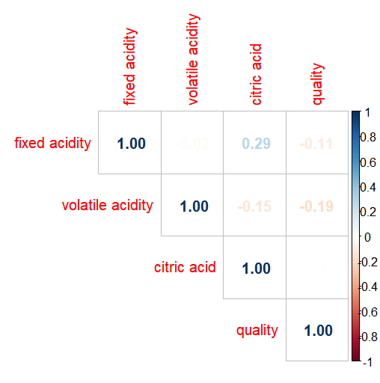
Correlation Analysis
Correlation Coefficents
+1 indicates a perfect positive linear relationship (as one variable increases, the other also increases).
-1 indicates a perfect negative linear relationship (as one variable increases, the other decreases).
0 indicates no linear relationship
The correlation matrix reveals the strength and direction of relationships between variables, with values close to +1 indicating strong positive correlations and values close to -1 indicating strong negative correlations.

Slide 7
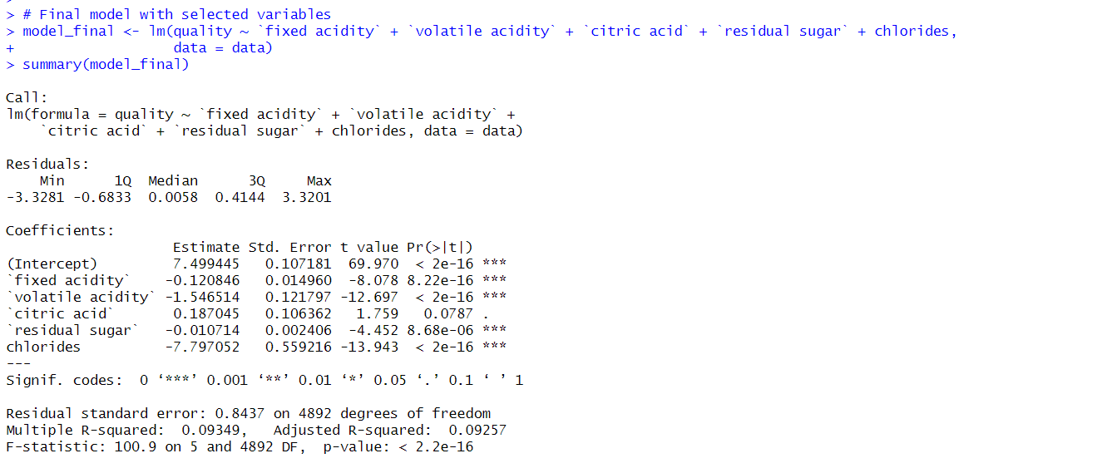

Regression Analysis
Regression Analysis with Selected Variables for Wine Quality Prediction
Final Regression Model for Wine Quality
Quality = Intercept + (β₁ * Fixed Acidity) + (β₂ * Volatile Acidity) + (β₃ * Citric Acid) + (β₄ * Residual Sugar) + (β₅ * Chlorides)
Insights:
Significant Predictors:
Volatile Acidity and Chlorides have strong negative impacts.
Fixed Acidity and Residual Sugar also negatively affect quality.
Citric Acid has a positive but marginal effect.
Model Fit:
R² = 9.35%, Adjusted R² = 9.26%
F-statistic: 100.9 (p < 2.2e-16) – model is significant but explains limited variance.

Slide 8
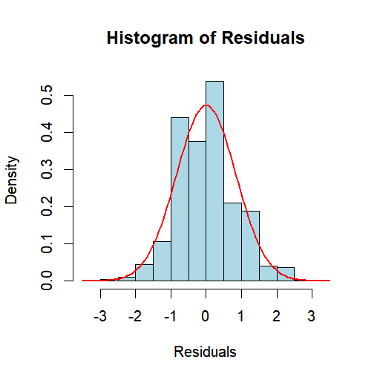
Residual Analysis
Histogram of Residuals
The histogram shows a relatively symmetric, bell-shaped distribution, suggesting the residuals are approximately normally distributed.
Minimum residual: -3.8348
Maximum residual: 3.1143
Potential outliers present, but overall distribution is reasonably well-behaved.
Residual Summary Statistics
Min: -3.8348
1Q: -0.4934
Median: -0.0379
3Q: 0.4637
Max: 3.1143
The median residual value close to 0 and the interquartile range indicate a symmetric distribution.

Slide 9
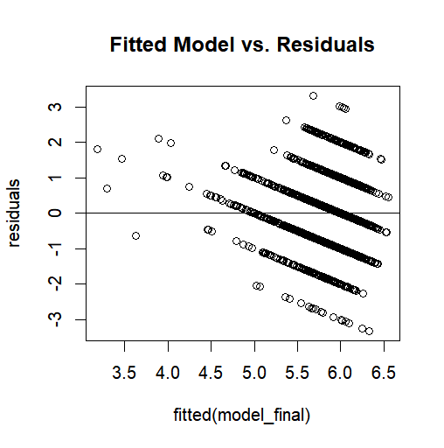
Residual Analysis
Assumptions Assessment
Normality: The histogram and summary statistics support the assumption of normally distributed residuals.
Constant Variance: The consistent spread of residuals across the range suggests constant variance.
Independence: No obvious patterns or trends in the residuals indicate independence.
Conclusion
The residual analysis indicates the model assumptions are reasonably satisfied.
While some potential outliers are present, the overall model appears to be well-specified and the residuals demonstrate appropriate statistical properties.

Slide 10
Summary
Correlation Analysis
Correlation Coefficient
Correlation Coefficients Between Fixed Acidity and Quality of White Wine:
Spearman: -0.0845
Pearson: -0.1137
Kendall: -0.0655
These negative values indicate a weak inverse relationship. As fixed acidity increases, quality slightly decreases, but the correlation is not strong.
Linear Regression
Regression Equation: Quality = Intercept + (β₁ * Fixed Acidity) + (β₂ * Volatile Acidity) + (β₃ * Citric Acid) + (β₄ * Residual Sugar) + (β₅ * Chlorides)
R² = 9.35%, Adjusted R² = 9.26%
F-statistic: 100.9 (p < 2.2e-16) – model is significant but explains limited variance.
Residual Analysis
Normality: Normally Distributed

